Slide 1


STATISTICAL LEARNING
Predicting youtube videos' popularity
G11
Riccardo Agabiti 2027220
Andrei Caraman 1664744
Filippo Mastrogiacomo 1824217
Roberta Padula 1808389
Simone Piperno 1792917

Slide 2






TABLE OF CONTENTS
INTRODUCTION TO PROJECT (SLIDES 1-2)
DATA SOURCE & DATA COLLECTION (SLIDE 3)
PREPROCESSING & FEATURE ENGINEERING (SLIDES 4-6)
DATA ANALYSIS & DATA VISUALIZATION
(SLIDES 7-9)
METHODS & INTERPRETABILITY
(SLIDES 10-12)
CONCLUSION
(SLIDES 13-15)
REFERENCES (SLIDE 16)

Slide 3
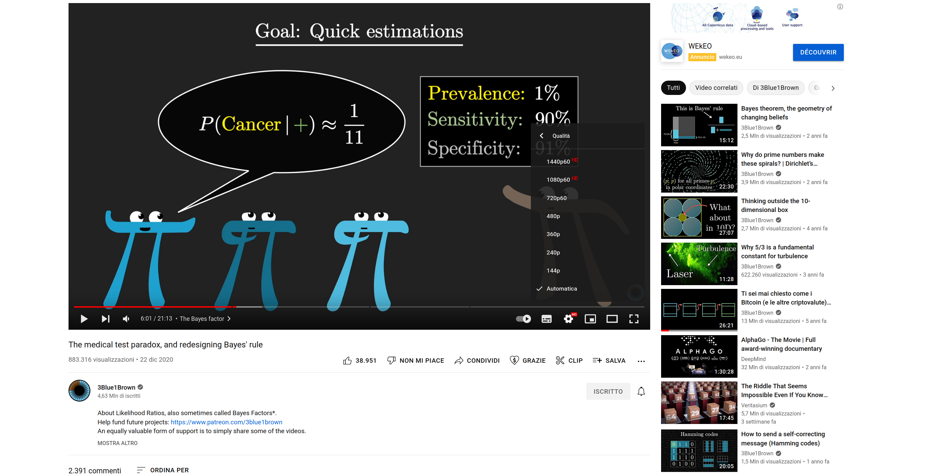
DATA SOURCE & DATA COLLECTION
We made use of ”Youtube-8M”, one of the biggest Youtube data repositories. From it we basically sampled random video URLs.
We proceeded mining videos' following features for ∼13000 videos:
+ Genre! (from metadata)

Slide 4
PREPROCESSING & FEATURE ENGINEERING
Handling titles:
Title's information was turned into a scalar according to the intuition that given the fact that some words have multiple meanings the titles using those kind of words should be more likely to be found. We implemented it as a 4-step procedure:
For each title lower all the characters, remove the stopwords and then stem all the words.
Create a dictionary having as keys the single words and as values the frequency with which the word appeared.
Compute the probability of the title as the sum of the probabilities of the single words.
Normalize the such achieved feature of titles' probabilities using a min-max normalization.
Duration:
We took only the information relative to the minutes, leaving out the information about seconds.
Genre:
The genres were simply encoded into numeric labels (0,1,2....).

Slide 5
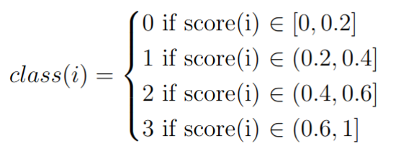
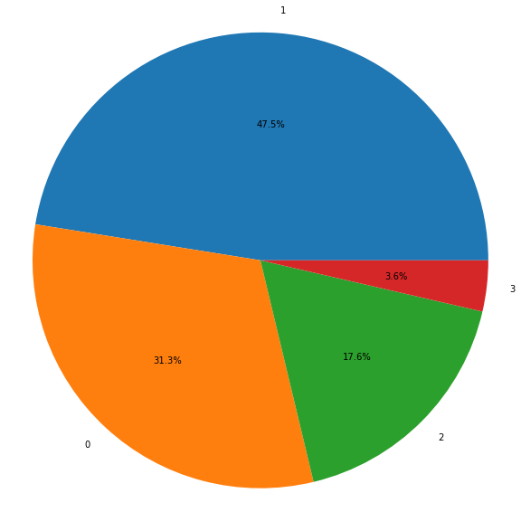
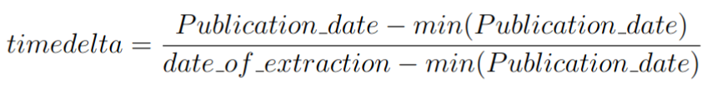
PREPROCESSING & FEATURE ENGINEERING
Define classes:
Classes for each video were defined using this function
Where the score is computed as
And timedelta is defined as
Distribution of the classes.

Slide 6
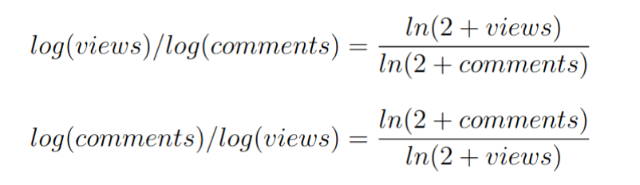
PREPROCESSING & FEATURE ENGINEERING
Feature engineering:
Only 2 features were added, which are defined as follows:

Slide 7
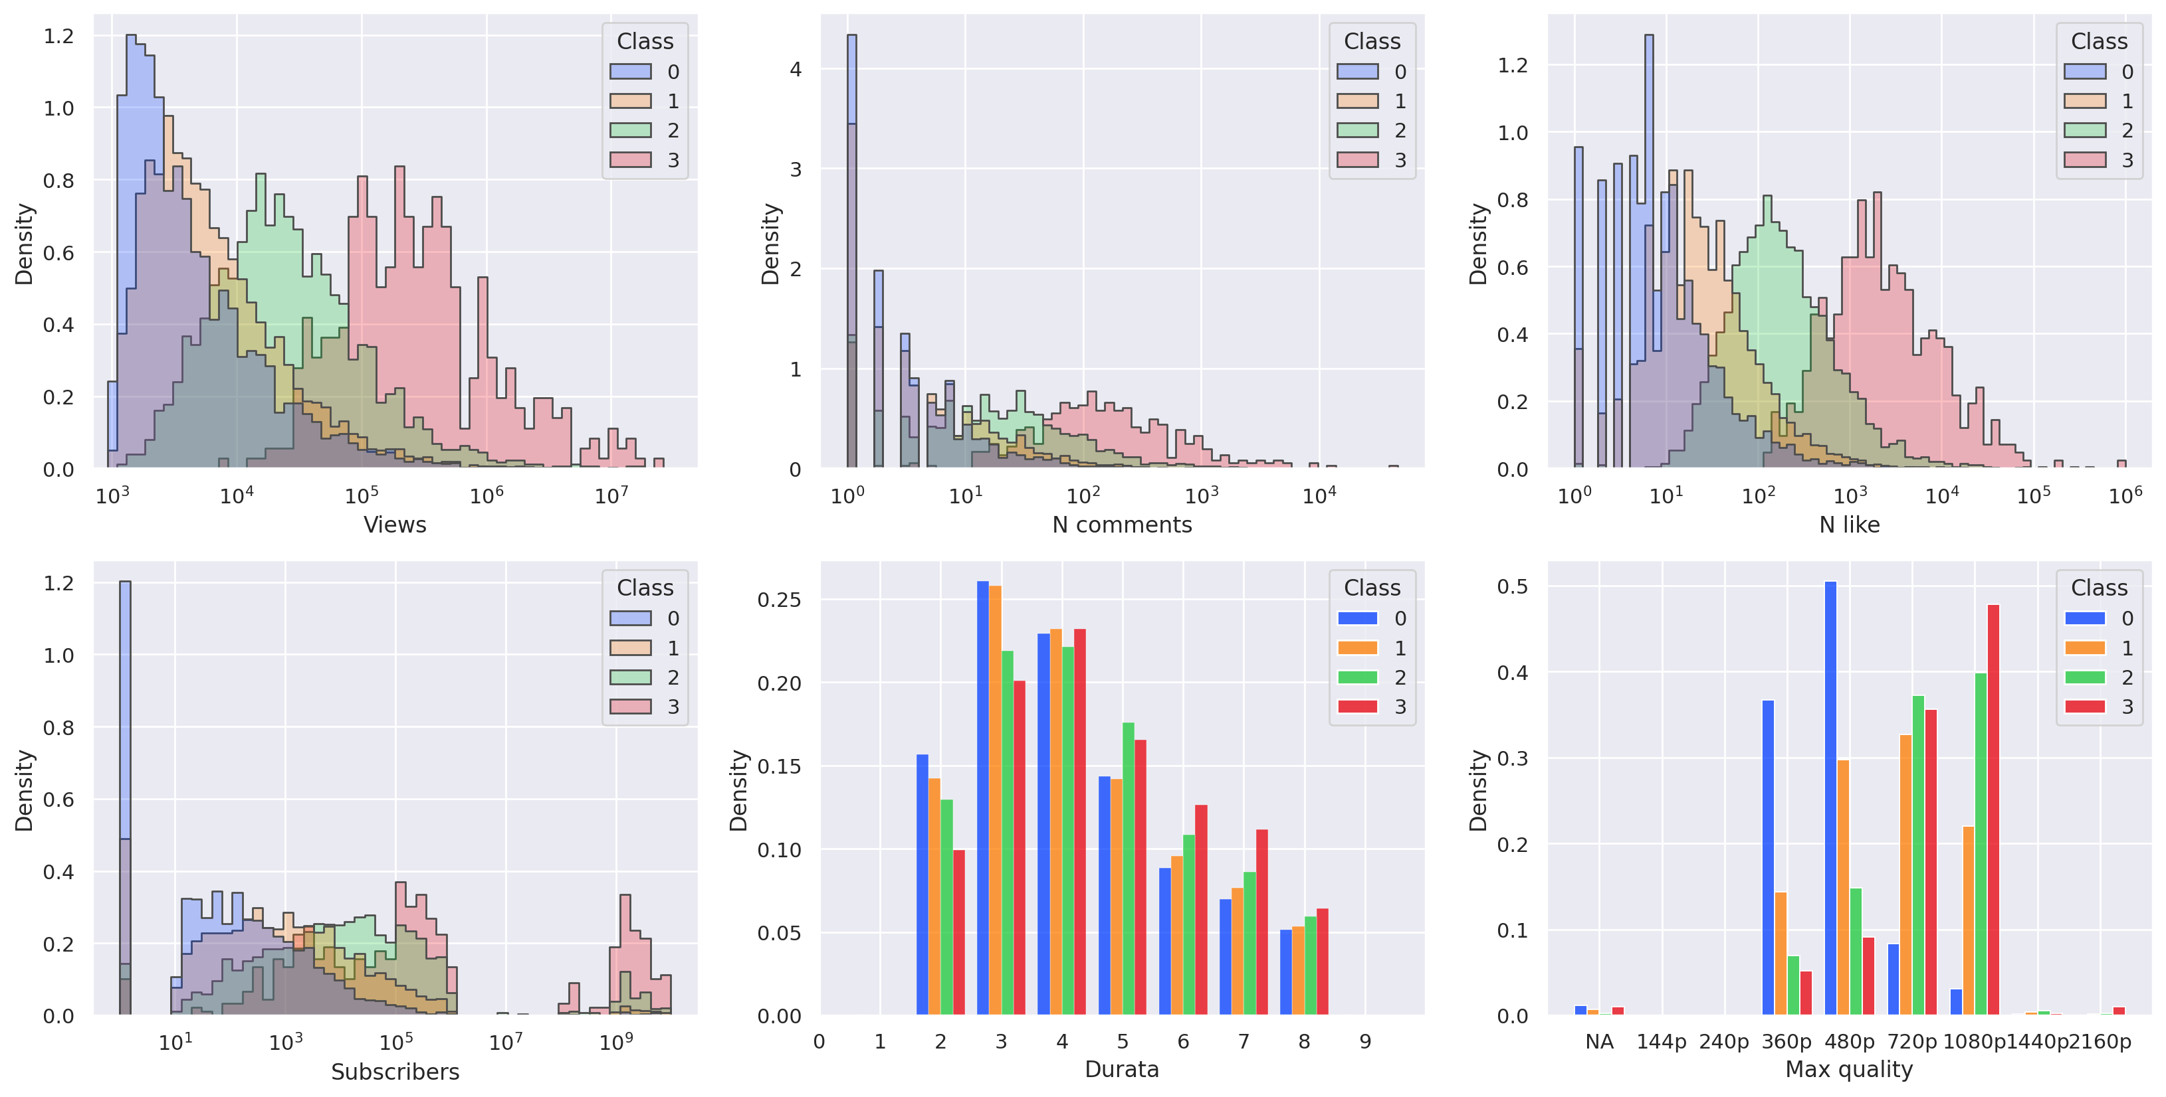
DATA ANALYSIS & DATA VISUALIZATION

Slide 8
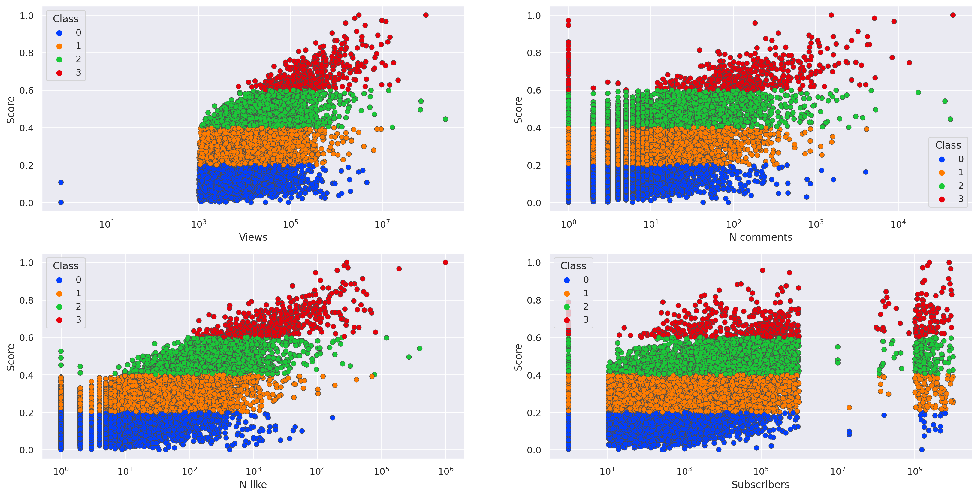
DATA ANALYSIS & DATA VISUALIZATION

Slide 9
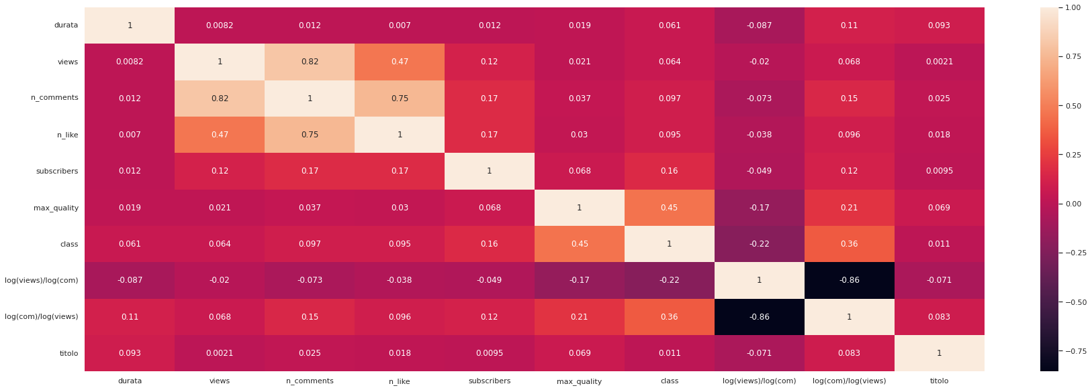
DATA ANALYSIS &
DATA VISUALIZATION

Slide 10
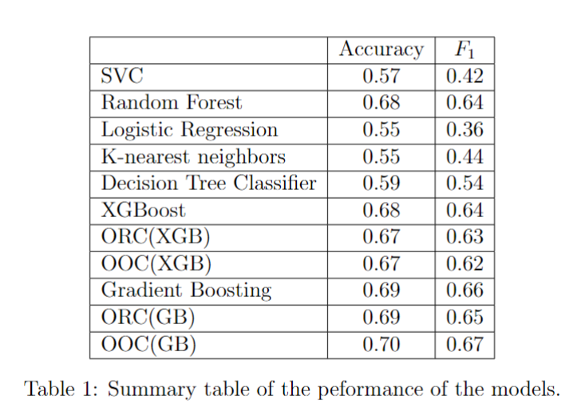
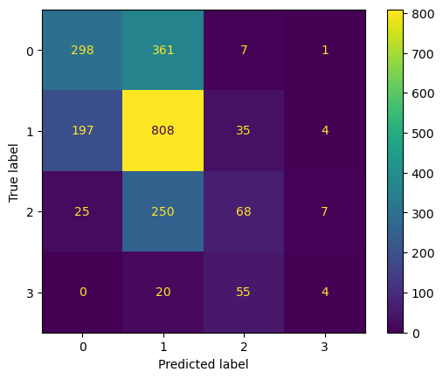
METHODS & INTERPRETABILITY
Confusion matrix for logistic regression

Slide 11
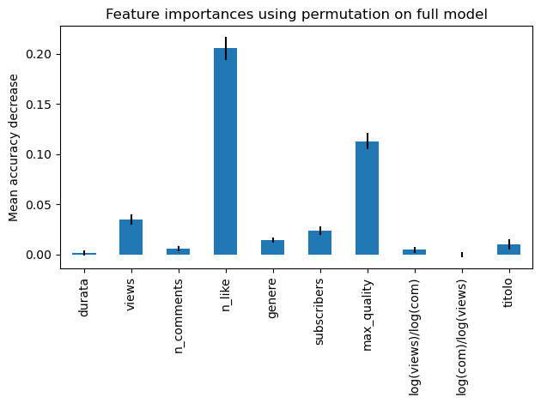
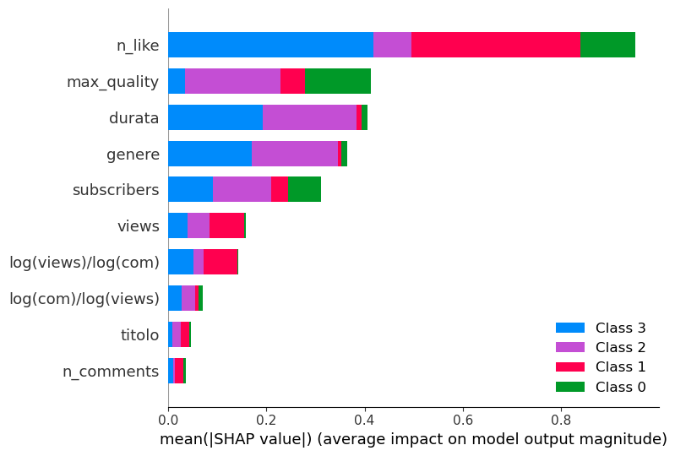
METHODS & INTERPRETABILITY
Random Forest Interpretation methods
Feature permutation
SHapeley Addictive exPlanation (SHAP)

Slide 12
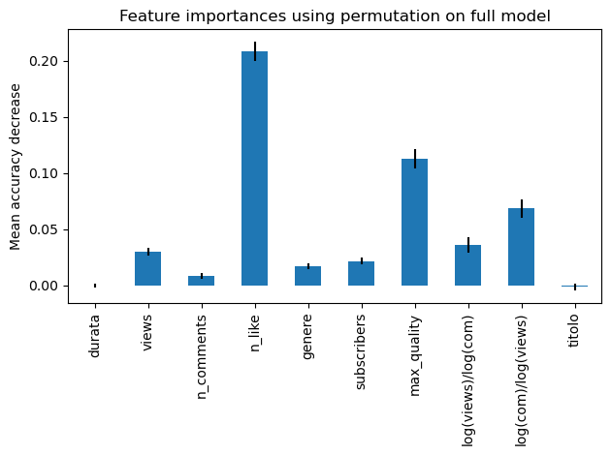
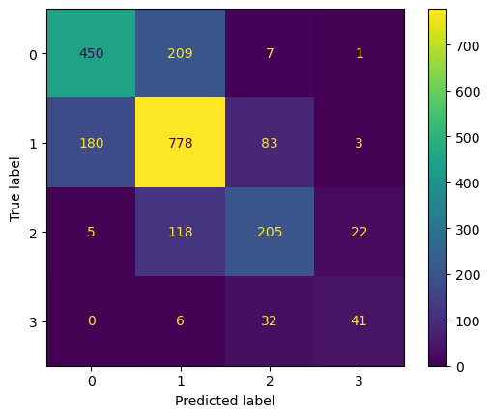
METHODS & INTERPRETABILITY
Gradient Boosting Interpretation methods
Confusion Matrix for Gradient Boosting
Feature permutation

Slide 13
CONCLUSION
Intuition Gained
A successful youtuber in order to seek popularity should:
. Produce content that increase the number of interactions such as likes.
. Follow a trending genre such as gaming, sports or entertainment.
. Produce high quality video.

Slide 14
CONCLUSION
Issues addressed
. Performance (main issue) : not surpassing 0.7 accuracy threshold was quite disappointing.
. False Friend Features: many features extracted were not as important as expected.
. Dataset Dimension: may need a bigger dataset (and maybe more computational capacity) in order to improve metrices.

Slide 15
CONCLUSION
For further development:
. Add as a feature also the thumbnail of
the videos.
. Make a deeper analysis of the titles.

Slide 16
REFERENCES
S. Abu-El-Haija, N. Kothari, J. Lee, P. Natsev, G. Toderici, B. Varadarajan, and S. Vijayanarasimhan. Youtube-8m: A large-scale video classification benchmark.[2016]
Y. Li1, K. Eng1, and L. Zhang. Youtube videos prediction: Will this video be popular?[2019]
S. M. Lundberg and S.-I. Lee. A unified approach to interpreting model predictions.[2017]
M. U. Nisa, D. Mahmood, G. Ahmed, S. Khan, M.A.Mohammed,and R. Damaˇseviˇcius. Optimizing prediction of youtube video popularity using xgboost.[2021]
C. Rudin. Stop explaining black box machine learning models for high stakes decisions and use interpretable models instead.[2019]
G. G. E. Scott M. Lundberg and S.-I. Lee. Consistent individualized feature attribution for tree ensembles.[2018]

